Slide 1


Upper Coastal Plain Rural Planning Organization (UCPRPO)
TAC Meeting
May 11, 2022
Edgecombe County - Johnston County – Nash County – Wilson County
The meeting will begin at 3:00 PM
Please mute your line if you have not already done so.

Slide 2
UCPRPO TAC Meeting
Edgecombe County - Johnston County – Nash County – Wilson County
May 11, 2022
Meeting Guidelines
Please keep your microphone on mute until you are ready to make a comment or ask a questions.
Turn your microphone on to speak but remember to turn it off once you have finished.
Begin with stating your name so everyone will know who is speaking.
You may use the chat feature to send a note. The chat will be checked, but please get my attention if I fail to respond quickly.
All votes will be completed by roll call as per NCGS 166A-19.24(b)(5). When the chair calls for a vote, I will call roll and ask each person to respond with a ‘yes’ or ‘no’.
Please remember to mute yourself again after roll call.
Please keep microphone muted
Chat is enabled

Slide 3
UCPRPO TAC Meeting
Edgecombe County - Johnston County – Nash County – Wilson County
May 11, 2022
1. Welcome & Introductions – C.B. Brown – TAC Chair
2. ETHICS AWARENESS & CONFLICT OF INTEREST REMINDER
In accordance with the State Government Ethics Act, it is the duty of every [Board] member to avoid conflicts of interest.
Does any [Board] member have any known conflict of interest with respect to any matters coming before the [Board] today?
If so, please identify the conflict and refrain from any participation in the particular matter involved.
ALL MEMBERS COMPLETED THEIR 2022 ETHICS FILINGS – THANK YOU!!!

Slide 4
UCPRPO TAC Meeting
Edgecombe County - Johnston County – Nash County – Wilson County
March 9, 2022
3. APPROVAL OF UCPRPO TAC MEETING AGENDA
Looking for a motion and a 2nd to accept agenda….. Then roll call
There has been a request to add for consideration the adoption of a resolution of support for the Town of Wilson’s Mills Bicycle and Planning Grant Application.

Slide 5
UCPRPO TAC Meeting
Edgecombe County - Johnston County – Nash County – Wilson County
May 11, 2022
4. APPROVAL OF UCPRPO TAC MEETING MINUTES
Review and approval of the March 9, 2022 minutes with a motion and second….. Then roll call

Slide 6
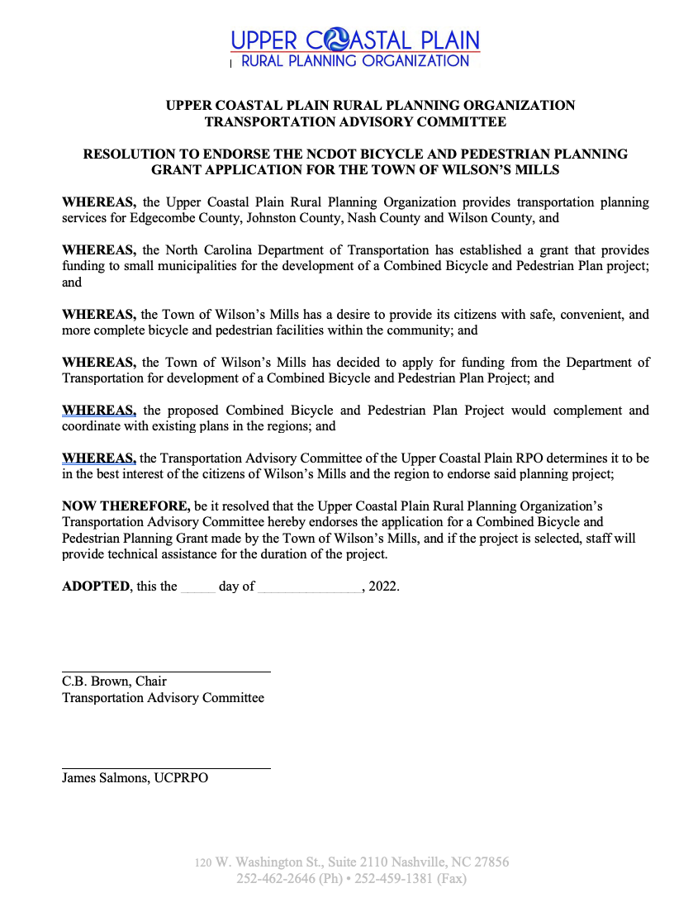
UCPRPO TAC Meeting
Edgecombe County - Johnston County – Nash County – Wilson County
May 11, 2022
5a. ENDORSEMENT OF TOWN OF WILSON’S MILLS BICYCLE AND PEDESTRIAM PLANNING FUNDING APPLICATION
Staff is recommending and requesting a motion to adopt a resolution of support for the Town of Wilson’s Mills Bicycle and Pedestrian Planning Grant Application………. Is there a motion and second….. Then roll call

Slide 7
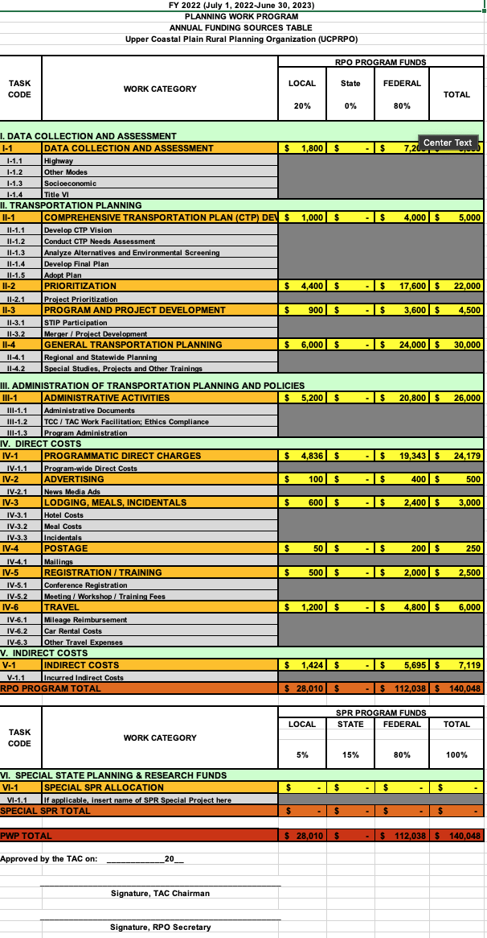
UCPRPO TAC Meeting
Edgecombe County - Johnston County – Nash County – Wilson County
May 11, 2022
5. Planning Work Program FY22 Amendments (PWP)
A copy of the proposed FY22 PWP Amendment was included within the TAC agenda packet.
Staff is requesting an Amendment to the UCPRPO FY22 PWP:

Slide 8
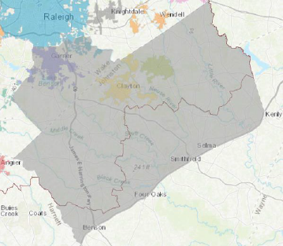
UCPRPO TAC Meeting
Edgecombe County - Johnston County – Nash County – Wilson County
May 11, 2022
5. Planning Work Program FY22 Amendments (PWP)
The SEAS Update is an update to the original 2017 Southeast Area Study that looked at land use and multimodal transportation needs of the study area shown here. The study covered parts of Wake and Johnston Counties, and the municipalities of Archer Lodge, Benson, Clayton, Four Oaks, Garner, Kenly, Micro, Raleigh, Selma, Smithfield and Wilson’s Mills, and was conducted in coordination with NCDOT and the Upper Coastal Plain RPO. This update will produce recommendations across all modes as well as refresh policies and priorities that may have evolved since the original study.
Recommendations from the SEAS Update will inform the Metropolitan Transportation Plan, which is a region-wide long-range transportation plan updated every 4 years and the RPO of transportation needs within the study area.
The study started in February of 2022 and be completed by June 2023.

Slide 9
UCPRPO TAC Meeting
Edgecombe County - Johnston County – Nash County – Wilson County
May 11, 2022
5. Planning Work Program FY22 Amendments (PWP)
Amendment Purpose 1: Add $75,000 in funding for the Southeast Area Study (SEAS). The SEAS a partnership between CAMPO and UCPRPO to provide an update to the current plan. The plan helps identify transportation needs over the next 30 years. This is additional funding approved by NCDOT to apply towards the SEAS. Johnston County has agreed to provide the 5% local match requirement. There is no additional local match required by other UCPRPO member Counties.
Amendment Purpose 2: Provide additional funding to the ”Special Studies” task to account for the additional effort to administer the NRT and SEAS . The request moves $10,000.00 from the Task IV-1.1- ”Program-wide Direct Costs” to the Task II-4.2 “Special Studies, Projects and Other Trainings”. This does not change funding total and only reallocates funding from one category to another.
VI. Special SPR Allocation
This category is increased by $75,000 to reflect the recently approved SPR funding allocated to the UCPRPO to aid in funding the Southeast Area Study (SEAS). The SEAS is a study in partnership with CAMPO to provide long range transportation planning for areas within the UCPRPO jurisdiction in eastern Johnston County. The funding requires a 5% local match of which Johnston County has agreed to fund in full. There will be no local match required of other UCPRPO members.
II-4 General Transportation Planning
This category is increased by $10,000 to fund the additional effort needed to administer the Special Study Neuse River Trail Study (NRT). The NRT was previously approved by the UCPRPO TAC at it’s July 2021 regular meeting. This amendment will not change the total amount of funding, but rather shift funding between categories.
IV-1 Programmatic Direct Charges
This category is reduced by $10,000 to reflect the increase in funding category II-4 General Transportation Planning. This amendment will not change the total amount of funding, but rather shift funding between categories.

Slide 10
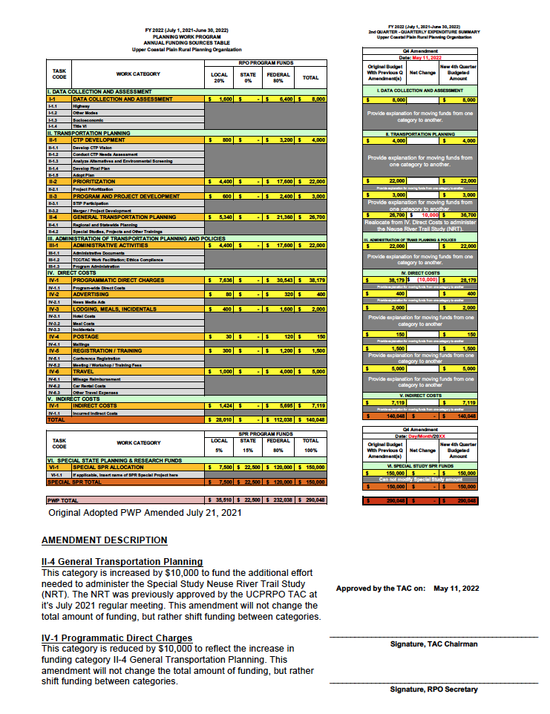
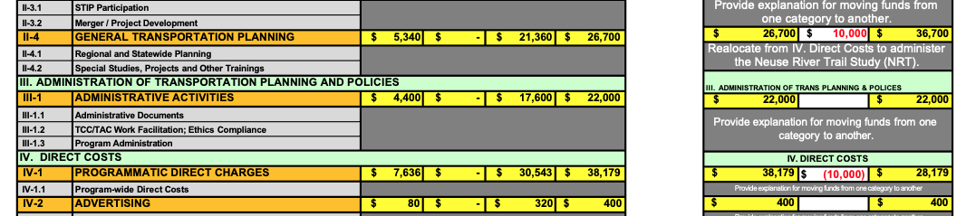
UCPRPO TAC Meeting
Edgecombe County - Johnston County – Nash County – Wilson County
May 11, 2022
5. Planning Work Program FY22 Amendments (PWP)

Slide 11
UCPRPO TAC Meeting
Edgecombe County - Johnston County – Nash County – Wilson County
May 11, 2022
5. Planning Work Program FY22 Amendments (PWP)
Staff is seeking a motion to recommend adoption of the UCPRPO 4th Quarter Amendment to the FY22 PWP to the TAC………..

Slide 12
2024-2033 STIP Development
UCPRPO TAC Meeting
Edgecombe County - Johnston County – Nash County – Wilson County
May 11, 2022
6. STIP Education
May 2022

Slide 13

Today’s Topics
UCPRPO TAC Meeting
Edgecombe County - Johnston County – Nash County – Wilson County
May 11, 2022
Background
STIP Development
STIP Format
Project Prioritization Status
Next Steps / Schedule
Discussion

Slide 14
Background

Slide 15
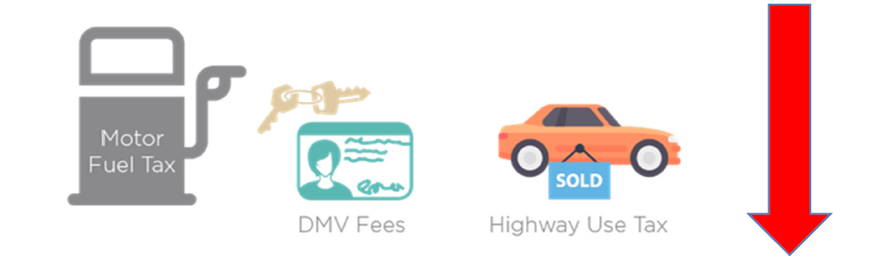
STIP Budget Changes
COVID – Revenues affected
$8B+ in cost increases since July 2020 (1,000+ estimates updated)
Many increases due to outdated or low estimates
Processes in place to ensure more accurate estimates moving forward
New budgets provided $3.8B in additional revenue
Federal Infrastructure Investment and Jobs Act (IIJA)/Bipartisan Infrastructure Law (BIL)
State Budget
Inflation adjustments
Board of Transportation approved changing from 1% compounded annually to 3% ($2.5B impact)
15

Slide 16
2024-2033 STIP Funding Availability for Committed Projects
Statewide Mobility
Regional Impact
Division Needs
Available Funding | Programming Status
$10.6B | $3.36B Over
Region | Available Funding | Programming Status
A (D1 & D4) | $647.5M | $383.2M Over
B (D2 & D3) | $919.2M | $391.2M Over
C (D5 & D6) | $1.78B | $297.1M Over
D (D7 & D9) | $1.33B | $596.7M Over
E (D8 & D10) | $1.67B | $756.5M Over
F (D11 & D12) | $881.0M | $455.7M Over
G (D13 & D14) | $676.1M | $982.2M Over
Division | Available Funding | Programming Status
1 | $569.7M | $129.5M Over
2 | $569.7M | $190.3M Over
3 | $569.7M | $77.3M Under
4 | $569.7M | $223.2M Under
5 | $569.7M | $172.4M Over
6 | $569.7M | $87.4M Under
7 | $569.7M | $65.4M Under
8 | $569.7M | $85.3M Over
9 | $569.7M | $31.6M Under
10 | $569.7M | $68.8M Over
11 | $569.7M | $102.4M Under
12 | $569.7M | $234.0M Over
13 | $569.7M | $325.7M Over
14 | $569.7M | $88.2M Over
REG Total: $3.86B Over
Total Overprogrammed: $8B
Includes estimated funding from Infrastructure and Investment Jobs Act (IIJA)/Bipartisan Infrastructure Law (BIL)
DIV Total: $706.9M Over
As of January 25, 2022. Available Funding reflects accounting for 3% inflation. Programming Status Amounts are compared to 100% of budget.

Slide 17
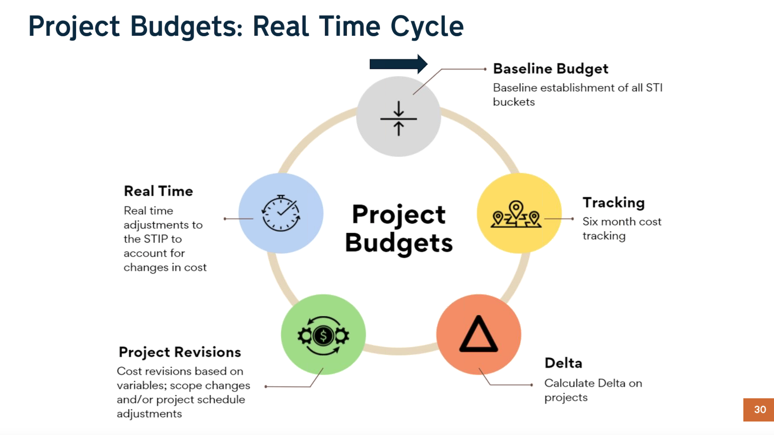
UCPRPO TAC Meeting
Edgecombe County - Johnston County – Nash County – Wilson County
May 11, 2022
6. STIP Education

Slide 18
2024-2033 STIP Development

Slide 19
Prioritization Workgroup Overall Goals
Develop trustworthy and dependable STIP (fiscally constrained)
Produce 2024-2033 STIP using current STIP project list with transparent process
Have an opportunity to fund new projects in P7 scoring (all 22 STI funding categories)
Ensure process is grounded in state/federal requirements

Slide 20
2024-2033 STIP Development (Framework)
Only includes projects funded in 2020-2029 STIP
Projects selected for funding using one of two approaches:
Delivery Projects – programmed first
  Currently scheduled for CON in FY 2024, 2025, or 2026; ROW underway; or has federal grant
P3-P4-P5 Evaluation (Seniority Approach) – programmed second
Opportunity to swap projects & project schedules following release of Draft STIP (April 25th)
  Swaps must be agreed to by NCDOT and MPO/RPO(s)
  Cost of project(s) swapped in must be within 10% of cost of project(s) being swapped out
Notes:
CON = Construction
ROW = Right-of-Way
FY = Fiscal Year

Slide 21
2024-2033 STIP Development – Visual
P3
P3
P4
P4
P4
P4
P4
P4
P5
P5
Start from Scratch
P5
P5
2024-2033 STIP
P5
P5
Delivery Projects
Remaining
Seniority Projects
21

Slide 22
2024-2033 STIP Development – Visual
P3
P3
P4
P4
P4
P4
P4
P4
Add Delivery
Projects
P5
P5
P5
P5
2024-2033 STIP
P5
P5
Remaining
Seniority Projects
22

Slide 23

2024-2033 STIP Development – Visual
P3
P3
P4
P4
Add additional projects following seniority approach until budget is expended for each funding bucket
P4
P4
P4
P4
P5
P5
P5
P5
2024-2033 STIP
P5
P5
Remaining
Seniority Projects
23

Slide 24

2024-2033 STIP Development – Visual
Swap projects as discussed and agreed upon by all partners
P3
P3
P4
P4
I don’t want that P4 project, I want that P5 project!
P4
P4
P4
P4
P5
P5
P5
P5
2024-2033 STIP
P5
P5
Remaining
Seniority Projects
24

Slide 25
2024-2033 STIP Development – Visual
Projects
reprioritized in P7 scoring
Release Revised Draft STIP
P4
P3
P3
P4
P5
P4
P4
P4
P4
Much better!
P5
P5
P5
P5
2024-2033 STIP
P5
Remaining
Seniority Projects
25

Slide 26

2024-2033 STIP Development (General Observations)
Delivery Projects:
Schedules for >80% of projects did NOT change!
P3-P4-P5 Evaluation (Seniority Approach):
Schedules for 34% of projects did NOT change
# and length of schedule changes varies by STI category
Other:
Some non-committed projects were programmed to meet STI minimum funding requirements

Slide 27
UCPRPO TAC Meeting
Edgecombe County - Johnston County – Nash County – Wilson County
May 11, 2022
6. DRAFT STIP Funded – Released April 25, 2022
SWAPABLE PROJECTS
COUNTY(S) | ROUTE/CITY | DESCRIPTION | MODE | PROJECT ID | STI CATEGORY FUNDED | CURRENT PRIORITIZATION STATUS | RIGHT-OF-WAY PROJECTED SCHEDULE | CONSTRUCTION PROJECTED SCHEDULE | TOTAL STI FUNDS | COMMENT
EDGECOMBE | TARBORO EDGECOMBE AIRPORT (ETC) | RUNWAY EXTENSION. | AVIATION | AV-5897 | DIVISION 4 | SCHEDULED FOR DELIVERY |  | 2028 | $3,790,000
EDGECOMBE | US 258 | SR 1601 (COLONIAL ROAD) TO US 64. WIDEN ROADWAY. | HIGHWAY | R-5949 | DIVISION 4 | SCHEDULED FOR DELIVERY | 2027 | 2029 | $28,200,000
JOHNSTON | I-95 | US 70 BUSINESS. UPGRADE INTERCHANGE. IN SMITHFIELD | HIGHWAY | I-5972 | REGION A | SCHEDULED FOR DELIVERY |  | 2024 | $19,501,000 | RIGHT-OF-WAY IN PROGRESS
JOHNSTON | I-95 | US 701/NC 96. CONSTRUCT INTERCHANGE. – FOUR OAKS | HIGHWAY | I-5974 | REGION A | SCHEDULED FOR DELIVERY | 2026 | 2028 | $55,521,000
JOHNSTON | NC 42 | SR 1003 (BUFFALO ROAD) TO WILSON COUNTY LINE. MODERNIZE ROADWAY. | HIGHWAY | U-5998 | DIVISION 4 | SCHEDULED FOR DELIVERY | 2026 | 2028 | $21,200,000
JOHNSTON | SR 1003 (BUFFALO ROAD) | US 70 TO SR 1934 (OLD BEULAH ROAD). WIDEN TO THREE LANES. | HIGHWAY | R-5718 | DIVISION 4 | SCHEDULED FOR DELIVERY | 2022 | 2025 | $22,427,000
JOHNSTON | SR 1501 (SWIFT CREEK ROAD) | AIRPORT INDUSTRIAL DRIVE TO DRIVEWAY JUST NORTH OF JOHNSTON COUNTY AIRPORT. WIDEN ROADWAY. | HIGHWAY | R-5950 | DIVISION 4 | SCHEDULED FOR DELIVERY | 2028 | 2030 | $4,500,000
JOHNSTON | US 301/NC 39/NC 96 | SR 1623 (BOOKER DAIRY ROAD) TO SR 2302 (RICKS ROAD). CONSTRUCT ACCESS MANAGEMENT IMPROVEMENTS. | HIGHWAY | U-5726 | DIVISION 4 | SCHEDULED FOR DELIVERY | 2025 | 2027 | $27,200,000
JOHNSTON | US 70 | WEST OF SR 2372 (EDWARDS ROAD / NORTH PEARL STREET) TO EAST OF SR 2314 (PONDFIELD ROAD). UPGRADE TO FREEWAY STANDARDS. | HIGHWAY | R-5829B | STATEWIDE MOBILITY | WILL BE REPRIORITIZED | FUNDED FOR PRELIMINARY ENGINEERING ONLY | FUNDED FOR PRELIMINARY ENGINEERING ONLY | $89,753,000
JOHNSTON | JOHNSTON COUNTY | PURCHASE EXPANSION VEHICLES. | PUBLIC TRANSIT | TA-6720 | DIVISION 4 | SCHEDULED FOR DELIVERY |  | 2026 | $33,000
NASH | NC 43 | SR 1613 (WOODRUFF AVENUE) TO I-95. | HIGHWAY | U-2561C | DIVISION 4 | SCHEDULED FOR DELIVERY | 2027 | 2029 | $13,699,000 | PLANNING/DESIGN IN PROGRESS.
WILSON | NC 58 (NASH STREET NW) | SR 1330 (AIRPORT ROAD)/SR 1332 (LAKE WILSON ROAD). IMPROVE INTERSECTION. | HIGHWAY | U-6111 | REGION A | SCHEDULED FOR DELIVERY | 2028 | 2030 | $6,500,000
WILSON | SR 1309 (BLOOMERY ROAD) SR 1382 (PACKHOUSE ROAD) | US 264 ALTERNATE TO NC 58. WIDEN AND UPGRADE FACILITY. | HIGHWAY | U-5794 | DIVISION 4 | SCHEDULED FOR DELIVERY | 2022 | 2025 | $11,145,000
WILSON | US 264 ALTERNATE (RALEIGH ROAD PARKWAY) | SR 1320 (AIRPORT BOULEVARD) TO EAST OF SR 1165 (FOREST HILLS ROAD). SAFETY IMPROVEMENTS. | HIGHWAY | U-5941 | REGION A | WILL BE REPRIORITIZED | FUNDED FOR PRELIMINARY ENGINEERING ONLY | FUNDED FOR PRELIMINARY ENGINEERING ONLY | $27,000,000

Slide 28
UCPRPO TAC Meeting
Edgecombe County - Johnston County – Nash County – Wilson County
May 11, 2022
6. DRAFT STIP NOT Funded – Released April 25, 2022
SWAPABLE PROJECTS
COUNTY(S) | ROUTE/CITY | DESCRIPTION | MODE | DIVISION(S) | MPOs/RPOs | PROJECT ID | STI CATEGORY FUNDED | CURRENT PRIORITIZATION STATUS | TOTAL STI FUNDS
JOHNSTON | I-95 | SR 1007 (BROGDEN ROAD). IMPROVE INTERCHANGE. | HIGHWAY | 4 | UPPER COASTAL PLAIN RPO | I-6061 | NOT FUNDED | WILL BE REPRIORITIZED | $20,400,000
JOHNSTON | I-95 | SR 2339 (BAGLEY ROAD). IMPROVE INTERCHANGE. | HIGHWAY | 4 | UPPER COASTAL PLAIN RPO | I-6062 | NOT FUNDED | WILL BE REPRIORITIZED | $23,900,000
JOHNSTON | NC 242 | SR 1168 (TARHEEL ROAD) TO I-40. WIDEN ROADWAY. | HIGHWAY | 4 | UPPER COASTAL PLAIN RPO | R-5761 | NOT FUNDED | WILL BE REPRIORITIZED | $16,000,000
JOHNSTON | US 70 | US 301 TO I-95. ACCESS MANAGEMENT. | HIGHWAY | 4 | UPPER COASTAL PLAIN RPO | R-5795 | NOT FUNDED | WILL BE REPRIORITIZED | $20,731,000
WAYNE, JOHNSTON | US 70 | US 70 BYPASS TO WEST OF SR 2372 (EDWARDS ROAD / NORTH PEARL STREET). UPGRADE TO FREEWAY STANDARDS. | HIGHWAY | 4 | EASTERN CAROLINA RPO, GOLDSBORO URBAN AREA MPO, UPPER COASTAL PLAIN RPO | R-5829A | NOT FUNDED | WILL BE REPRIORITIZED | $149,579,000
WILSON | WILSON | WILSON CITY SIGNAL SYSTEM. | HIGHWAY | 4 | UPPER COASTAL PLAIN RPO | U-5945 | NOT FUNDED | WILL BE REPRIORITIZED | $7,300,000

Slide 29
2024-2033 STIP Format

Slide 30
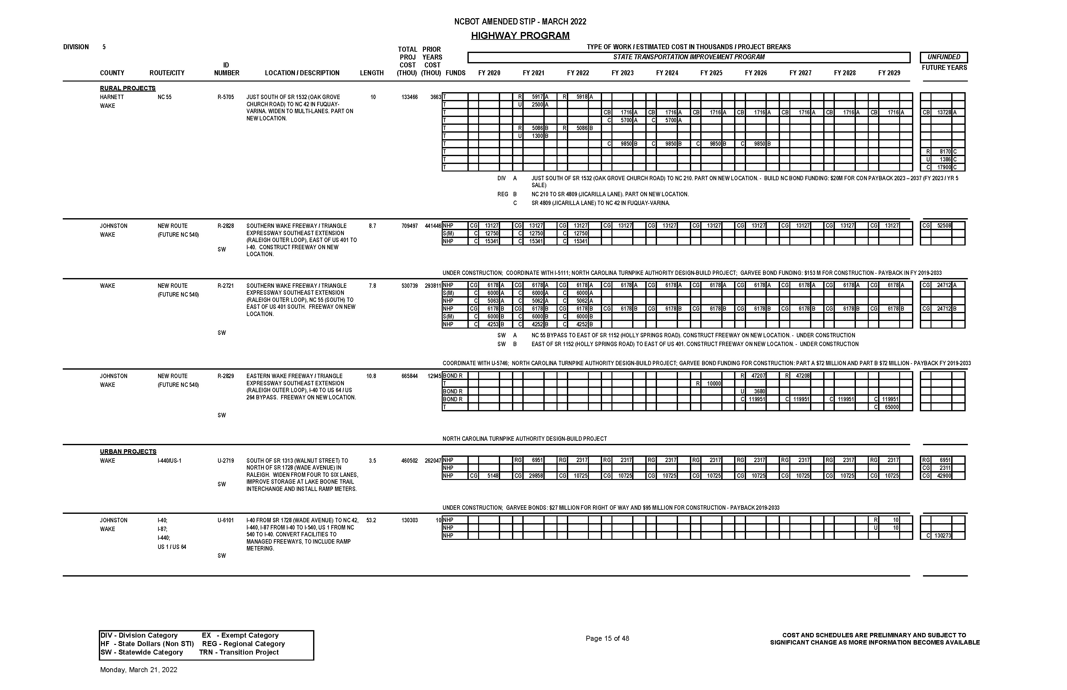
2020-2029 STIP Format – Not User Friendly

Slide 31
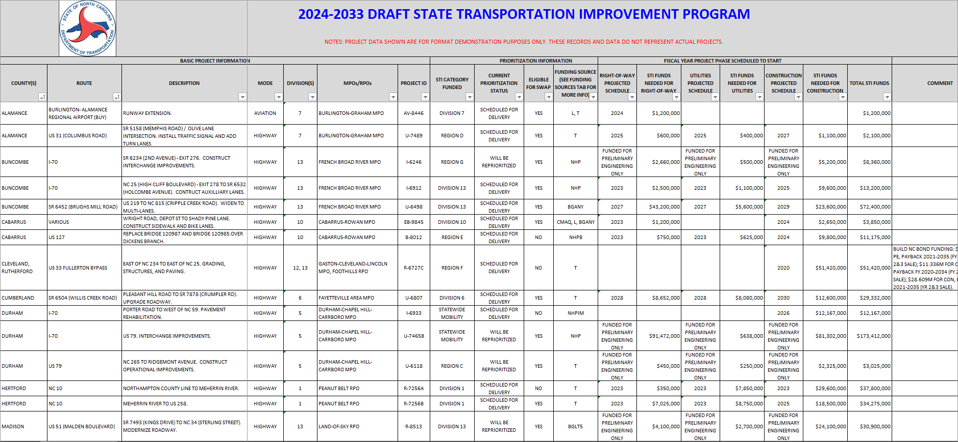
2024-2033 STIP Format – Excel-based
Note: These are not actual projects. Data shown is for illustrative purposes only.

Slide 32
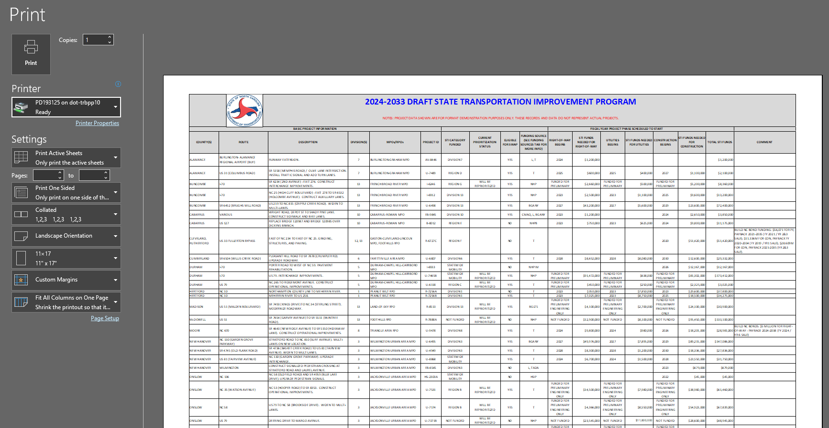
2024-2033 STIP Format – Print on 11x17

Slide 33
Next Steps / Schedule

Slide 34
2024-2033 STIP Next Steps / Schedule
Local Officials Education Webinar on May 17th
Commissioners, Councilmembers, Mayors, Managers, etc.
The next STIP Educational Webinar for Local Officials is scheduled for Tuesday, May 17, 2022 at 9:00am – 10:00am.
STIP coordination meetings with MPO/RPOs as needed
Project swaps due to STIP managers by September 30th
Revised Draft STIP by December 2022
Public Involvement
Final 2024-2033 STIP to be adopted by BOT in Summer 2023

Slide 35
Prioritization Next Steps and Schedule
P7 Workgroup will likely begin Fall 2022
P7 should generate the 2026-2035 STIP
Return to two-year Prioritization/STIP cycle
Anticipated P7 submittal window: Summer 2023
Anticipated P7 quantitative scores and 2026-2035 Statewide Mobility programming: Spring 2024
Notes:
Right around the corner to submit new projects
Same time BOT is adopting the STIP, submittal window will be opening for new projects

Slide 36
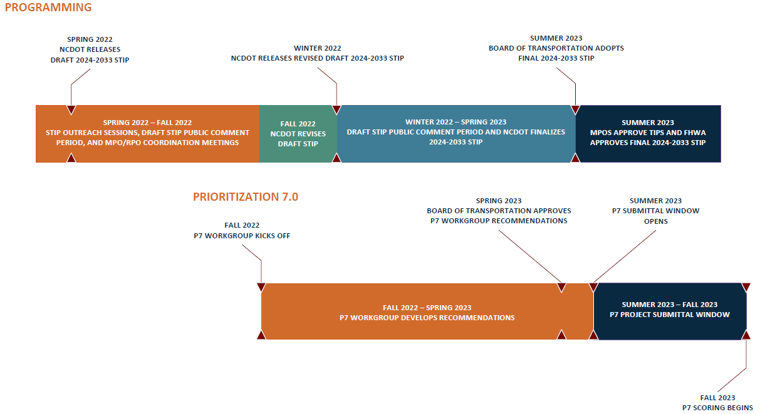
2024-2033 STIP Next Steps / Schedule

Slide 37
UCPRPO TAC Meeting
Edgecombe County - Johnston County – Nash County – Wilson County
May 11, 2022
7. NCDOT Clean Transportation Plan
​In​ January 2022, Gov. Roy Cooper signed Executive Order 246 (EO 246), “North Carolina’s Transformation to a Clean, Equitable Economy,” setting the course for North Carolina’s continued work to reduce economy-wide greenhouse gas emissions, advance environmental justice and create good paying jobs for North Carolinians throughout the state. This executive order builds upon 2018’s Executive Order 80​, which established a goal to reduce greenhouse gas emissions by 40 percent and increase zero-emission vehicle (ZEV) adoption to 80,000 vehicles by 2025.
The NCDOT Clean Transportation Plan Team is looking for input:
https://publicinput.com/NC-CleanTransPlan-Survey
Note: It has been reported that the NC State Legislatures are considering in the upcoming short session to divert sales tax revenue from transportation specific transactions to the Highway Trust Fund versus the General Fund. It is estimated that amount to be diverted is approximately $400-$500M per year.

Slide 38
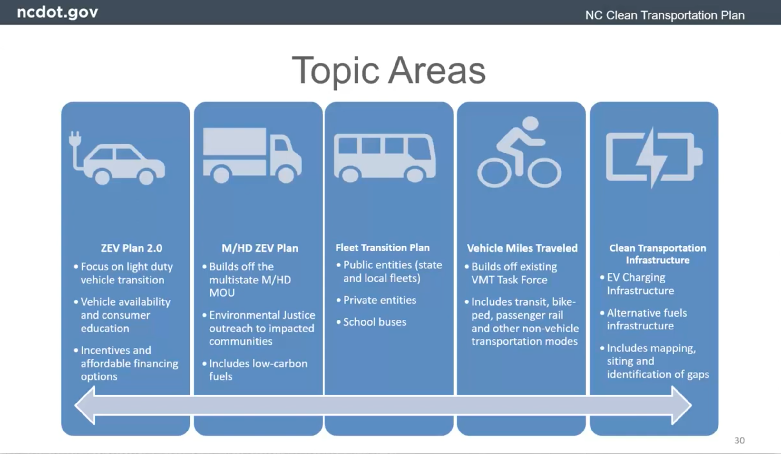
UCPRPO TAC Meeting
Edgecombe County - Johnston County – Nash County – Wilson County
May 11, 2022
7. NCDOT Clean Transportation Plan

Slide 39
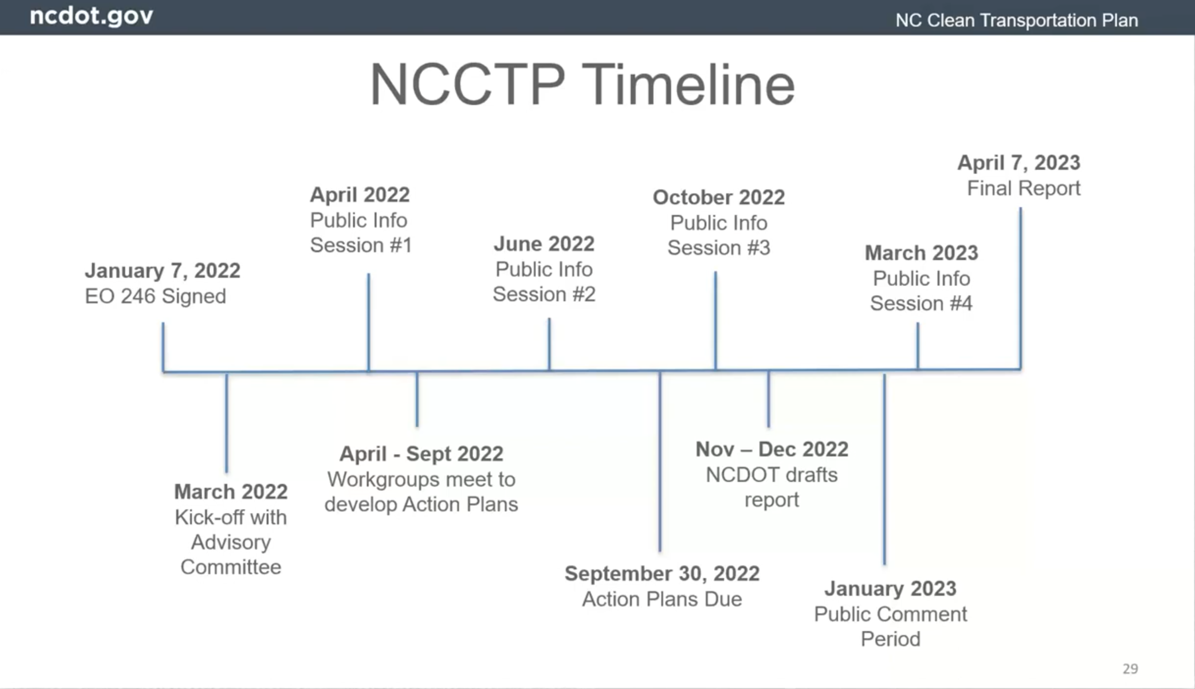
UCPRPO TAC Meeting
Edgecombe County - Johnston County – Nash County – Wilson County
May 11, 2022
7. NCDOT Clean Transportation Plan

Slide 40
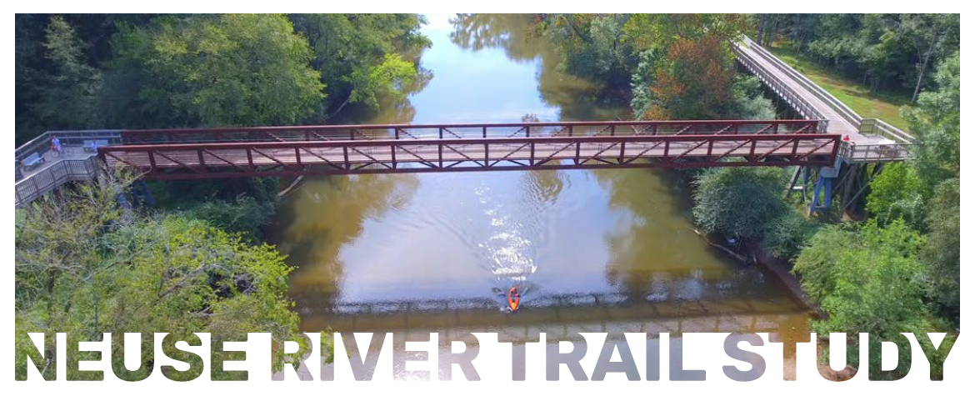
UCPRPO TAC Meeting
Edgecombe County - Johnston County – Nash County – Wilson County
May 11, 2022
8. Neuse River Trail Clayton to Smithfield Update
A Neuse River Trail Public meeting was held April 26th at the Smithfield Aquatics Center
The Project team continues to meet with landowners to help determine potential routes
Public Survey has had a HUGE response (as of 4/11/22):
  Over 659 participants
  11,046 responses
  1,383 comments
  226 subscribers
  1,840 views
  https://www.johnstonnc.com/parks/content.cfm?pageid=142

Slide 41



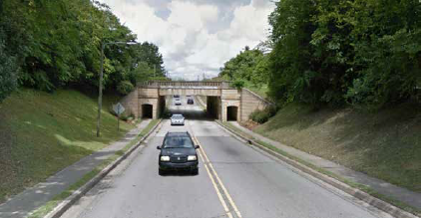
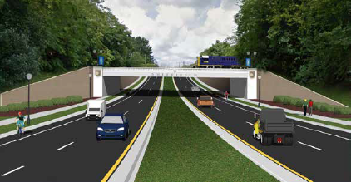
UCPRPO TAC Meeting
Edgecombe County - Johnston County – Nash County – Wilson County
May 11, 2022
9. Southeast Area Study Update
Kimley Horn has been selected as the consultant for the SEAS.
The project team is beginning to schedule bi-weekly calls.
The team is compiling a list of local jurisdiction representatives for both the Core Technical Team (CTT) and Stakeholder Oversight Team (SOT) to provide input from local public officials.
Study is expected to be completed by June 2023.
The Joint SOT and CTT kickoff meeting is scheduled for May 19th at 2:00pm to 4:00pm in the Town of Clayton’s Town Chambers
Below is a visual of Market St in Smithfield produced in a “Hot Spot” study from the last Southeast Area Study

Slide 42
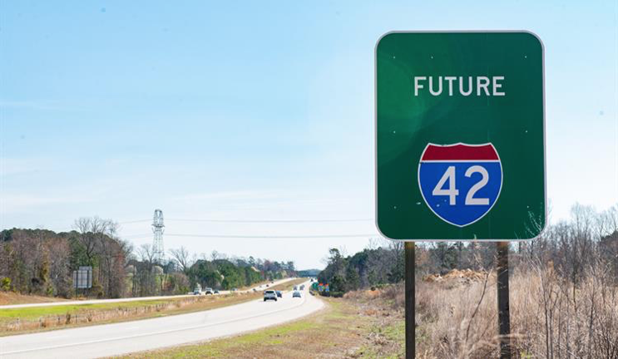
UCPRPO TAC Meeting
Edgecombe County - Johnston County – Nash County – Wilson County
May 11, 2022
10. US 70 Commission
The US 70 Commission last met on March 16th. John Sullivan from FHWA was on hand and announced that portions of US 70 have been officially designated as I-42.
Secretary Boyette was present and provided some brief remarks.
The State Hydraulics Engineer, Stephen Morgan provided a presentation on NCDOT Flood Resiliency efforts.
Special Recognition and Awards were presented to Secretary Jim Trogdon, Bobby Lewis, Tim Little, and John Rouse.
The following stretches of US 70 were announced as I-42:
Between I-40 and US 70 Bus interchange in Johnston County (10 miles)
Between US 70 Goldsboro Bypass in Wayne County to NC 903 interchange in Lenoir County (22 miles)

Slide 43
UCPRPO TAC Meeting
Edgecombe County - Johnston County – Nash County – Wilson County
May 11, 2022
11. Hwy 17/64 Association
The Hwy 17/64 Association met on April 27, 2022 virtually.
NCDOT new Chief Operating Officer – Joey Hopkins provided a brief update on the reprogramming of the STIP.
NCDOT plans to submit a grant application through the new IIJA to help fund I-87.
Divisions provided project updates along the corridor.
Next meeting is scheduled for Wednesday, June 9, 2022 via Zoom. Meeting are usually held at 10:00am.

Slide 44
UCPRPO TAC Meeting
Edgecombe County - Johnston County – Nash County – Wilson County
May 11, 2022
12. Legislative Update
The Joint Legislative Transportation Committee meet on April 7, 2022. Key notes from Committee meeting include:
Legislators were provided a presentation on the Rail Car fire that occurred in Nash County. There was approximately $395,000 in damage due to the fire. Arson is suspected.
A financial report was provided by NCDOT on the IIJA or Bipartisan Infrastructure Bill. The department is still working to determine the precise amount of additional revenue but anticipates the new revenue to only be around $200M +-.
NCDOT’s CFO provided an update on NCDOT finances. The department remains stable financially and cash balance and ongoing commitments are being monitored to ensure the department does not over commit. The Department is moving forward on the Build NC Bond in the amount of $300M.

Slide 45
UCPRPO TAC Meeting
Edgecombe County - Johnston County – Nash County – Wilson County
May 11, 2022
13. NCDOT Division 4 Update
NCDOT Division 4 Update
Jennifer Collins, P.E.
Division 4 Corridor Engineer
252-640-6436
jkcollins@ncdot.gov
Bridge projects in Edgecombe County that were halted should resume construction by mid June.

Slide 46
UCPRPO TAC Meeting
Edgecombe County - Johnston County – Nash County – Wilson County
May 11, 2022
14. NCDOT Transportation Planning Division (TPD) Update
TPD Update by:
Carlos Moya-Astudillo, EI
Planning Engineer, TPD
919-707-0934
cemoya@ncdot.gov

Slide 47
UCPRPO TAC Meeting
Edgecombe County - Johnston County – Nash County – Wilson County
May 11, 2022
15. NCDOT Integrated Mobility Division (IMD) Update
IMD Update by:
Nick Morrison
Regional Transportation Planner, IMD
919-707-2608
nemorrison@ncdot.gov

Slide 48
UCPRPO TAC Meeting
Edgecombe County - Johnston County – Nash County – Wilson County
May 11, 2022
16. TAC Member Comments
Any additional TAC Member Comments…………

Slide 49
UCPRPO TAC Meeting
Edgecombe County - Johnston County – Nash County – Wilson County
May 11, 2022
17. Public Comment
Public Comment

Slide 50
UCPRPO TAC Meeting
Edgecombe County - Johnston County – Nash County – Wilson County
May 11, 2022
Dates for future meetings
Future TAC Meeting Dates:
July 12, 2022
September 6, 2022
November 1, 2022
January 3, 2023

Slide 51
UCPRPO TAC Meeting
Edgecombe County - Johnston County – Nash County – Wilson County
May 11, 2022
Need a motion and a second for:
ADJOURNMENT
and
Roll Call
Next meeting: July 12, 2022

